Slide 1
IT166 Python for Data Science & Data Analytics Functions in Python
The goal of this class is to turn data into information, and information into insight that leads to do informed decisions.

Slide 2
Python functions in general
A Python function is a set of Python statements such that the statements can be run more than once in a program.
Python functions are the most basic program structure for maximizing code reuse.
Python functions are the building blocks for Python modules and classes.

Slide 3
Python functions V.S. Java methods
A Python Function | A Java Method
def getFive(): return 5 | public int getSix(){ return 6; }
Common features:
Name
Parameter list
return
Unique features of Python functions:
def
Compound statement
No return type

Slide 4

The def statement
The def statement creates a function object and assigns it to a name.
General format:
The return statement is optional.
What is the return type of a Python function that does not return anything?

Slide 5
Practice 1
Step 1:
Define a Python that prints ‘Hello world!’. Name the function as f1.
Step 2:
Use a for loop to call f1 10 times.

Slide 6
What’s the difference between the two functions?
def A():
print (5)
def B():
return 5

Slide 7
Practice 2
Step 1:
Define a Python function that takes two numbers as input. The function will add the two numbers together and return the sum. Name the function as f2.
Step 2:
Use a for loop to call f2 10 times and display the result for each function call.

Slide 8
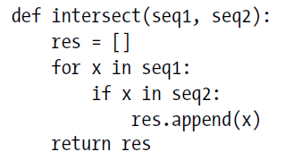
What does this function do?

Slide 9
Nested function
You can define a function inside another function.
def f1():
def f2():
return ‘whatever…’
print (f2())
Only f1 can be called from outside.

Slide 10
Python scopes
If function A is defined inside function B, it is local to function B, which means only function B can call function A.
If a variable is assigned (created) in function B, it can be access by all other functions that are nested in B, such as A.
If a variable is assigned (created) outside of all functions, it is global to all of them.

Slide 11

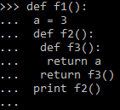
Examples

Slide 12
Find all the global and local variables and their scopes
apple = 56
if apple > 10:
banana = 60
def grape(a, b):
mellon = b - a
mellon += apple
def orange(banana):
return apple-banana
return orange(10)
print (grape(apple, banana), apple)

Slide 13
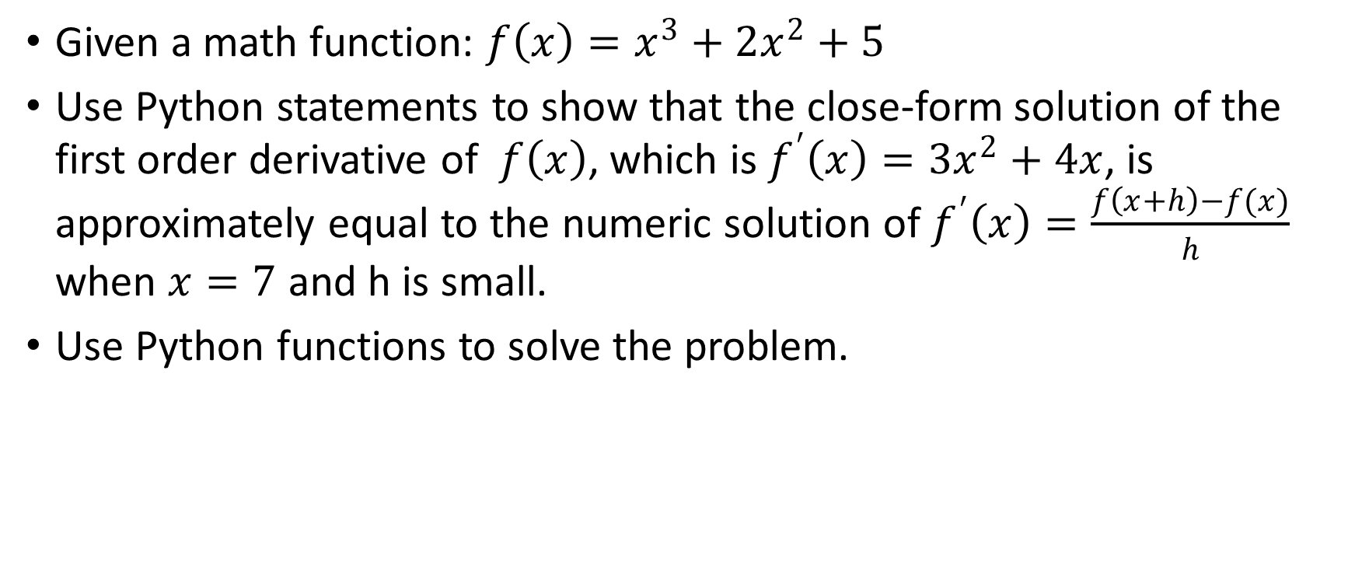
Practice 3
Given a math function: $f\left(x\right)=x^{3}+2x^{2}+5$
Use Python statements to show that the close-form solution of the first order derivative of $f\left(x\right)$, which is $f^{′}\left(x\right)=3x^{2}+4x$, is approximately equal to the numeric solution of $f^{′}\left(x\right)=\frac{f\left(x+h\right)−f(x)}{h}$ when $x=7$ and h is small.
Use Python functions to solve the problem.

